Slide 1
Enhancing Irrigation Water Management through Integration of Internet of Things (IoT) and Machine Learning (ML) Techniques
Bryan Nsoh, Graduate research assistant
University of Nebraska-Lincoln

Slide 2
Background
Importance and motivation for the study
Identification of knowledge gaps

Slide 3
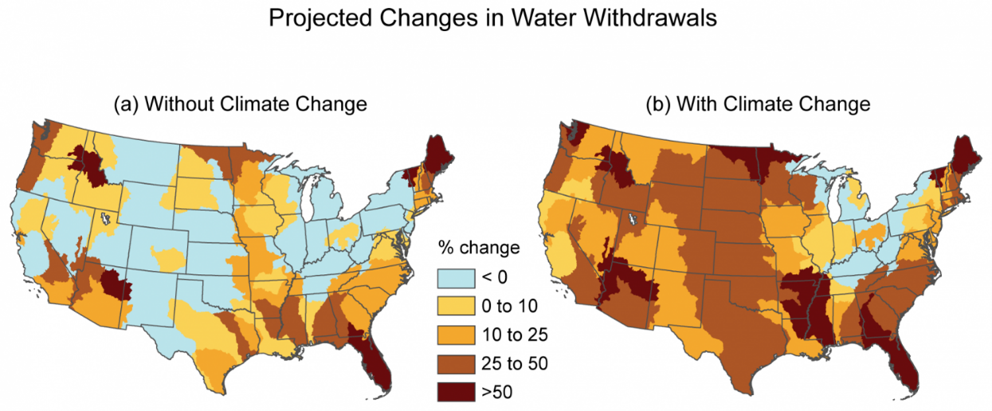
Problem Statement
Rising pressure on groundwater resources from climate change
Additional stress on the already burdened High Plains Aquifer
Need for efficient water-to-yield conversion to support the growing population
Notes:
High Plains Aquifer: A study highlights that in parts of the High Plains, groundwater resources are being rapidly depleted, compromising food security The research uses a model to predict reductions in groundwater withdrawal and subsequent declines in crop production For Nebraska, the model projects grain production to continue rising through 2050 due to high recharge rates, suggesting a relatively more sustainable situation compared to states like Texas (Mrad et al, 2020)
Impact of Climate Change: Climate change is also affecting groundwater availability and irrigation in the Republican River Basin, which is part of the US High Plains aquifer The study predicts that both groundwater pumping and recharge will increase, but the effects of pumping will dominate, leading to more pronounced declines in groundwater levels in areas with irrigation-driven decreasing trends (Ou et al, 2018)
Overall Water-Level Changes: A report on the High Plains aquifer indicates that water-level changes from predevelopment to recent years have included substantial declines in some areas The area-weighted average water-level changes in the aquifer showed an overall decline, indicating a net loss of groundwater over several decades (McGuire, 2011)

Slide 4
Challenges in optimizing AG water management
Lack of real-time, end-to-end systems for ag-water monitoring at scale
Need for interpretable, reliable predictive modelling to aid water use recommendations backed by live weather, plant and soil data

Slide 5
Research Objectives
Objective 1: Design of IoT scalable, low cost Platform that can integrate different sensor, datalogger and connections protocol types in low cost fashion and manage high data volumes
Objective 2: Design ML Algorithm that can integrate diverse data sources and metrics and combine their insights and synergies to accurately model sol and plant dynamics

Slide 6
Hypothesis
Hypothesis 1: An optimal, scalable IoT system will facilitate data-driven insights and integration of a wider suite of sensors
Hypothesis 2: An Ml system that makes use of a more diverse array of data and metrics will make more accurate irrigation scheduling decisions

Slide 7
Materials & Methods
Real Time Data collection and processing
Predictive modeling using LSTM

Slide 8
Field Layout
Sensor and node details:
TDR Sensors installed at depths of 6, 18, 30, and 42 inches.
Mounted IRT sensor, maintained at 1 meter above canopy height.
Dendrometer sensor placed around plant stem
Nodes equipped with Campbell CR-800 data loggers and raspberry pi with a lora hat.
Notes:
Say ET method, soil moisture sensor scheduling and IOT, each of these had 3 reps in both corn adn soybeans

Slide 9
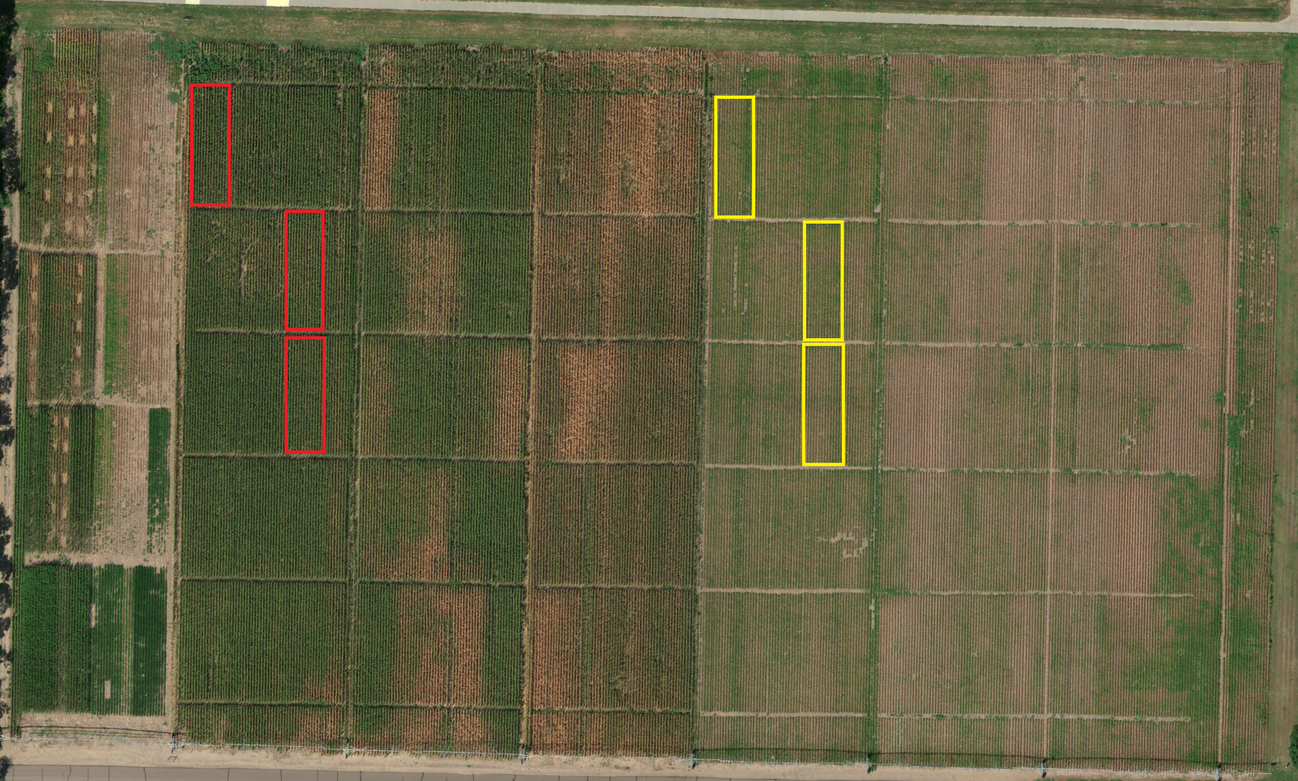
Location Overview: University of Nebraska-Lincoln West Central Research, Extension, and Education Center
Coordinates: Lat 411° N, Long 1008° W
Climate: Precipitation 21" (early summer), Temp: Summer 80s F, Winter 10s F
Soil: Cozad Silt Loam (Organic Matter 088%, Clay 16%, Sand 356%, Silt 484%, Slope 0-3%, pH 64)
Groundwater: Ogallala Aquifer (Depth 8-12 ft)
Experiment: IoT, 1 Replication, 3 Treatments
Red: Corn, Yellow: Soybean
Notes:
Show nodes in image with starts or something. can be estimate

Slide 10
DATA COLLECTION & pROCESSING

Slide 11
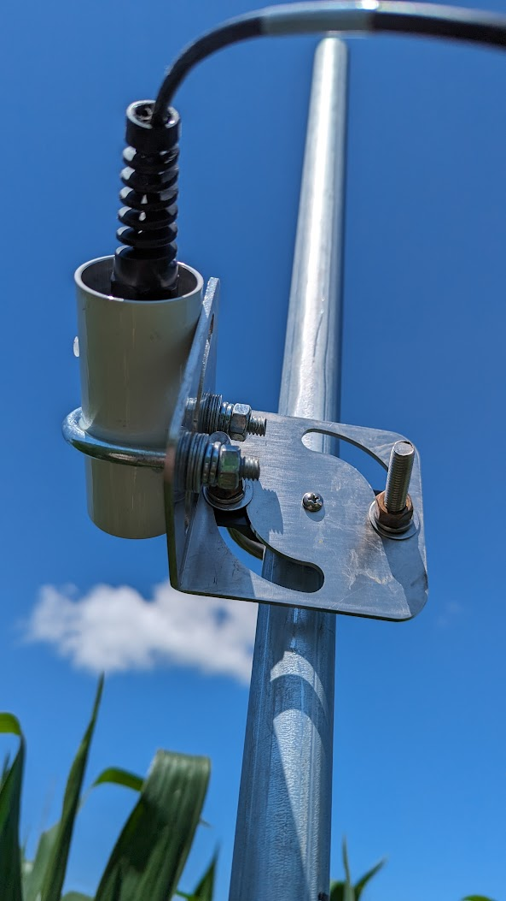
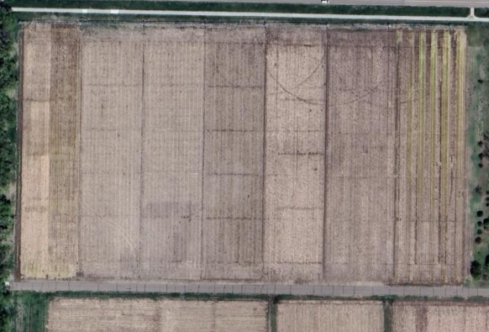
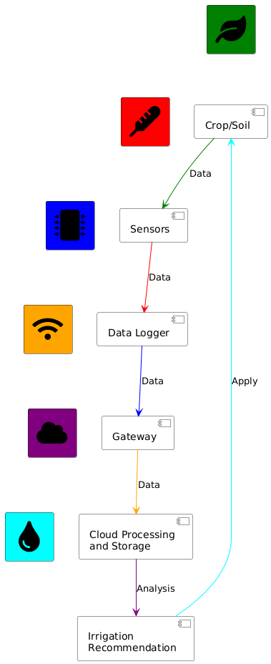


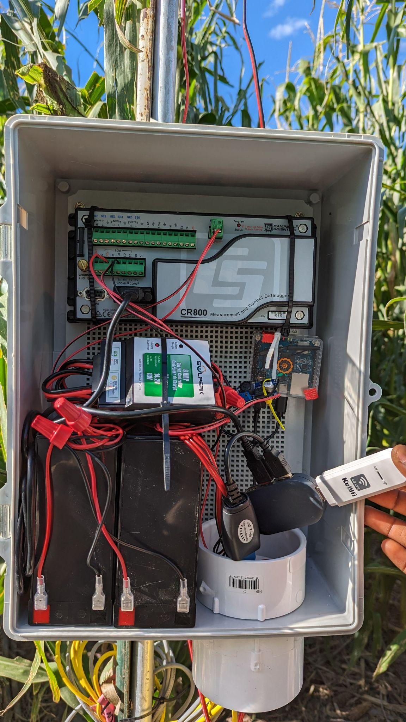
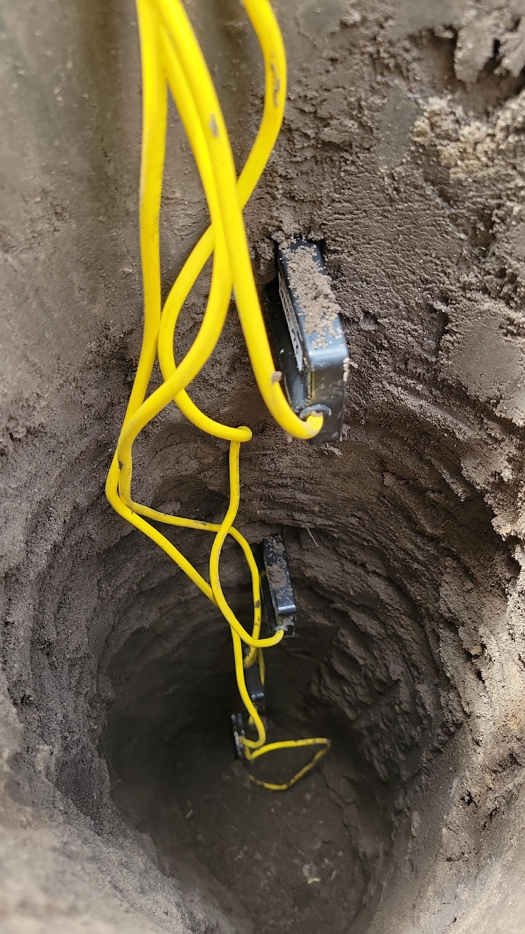
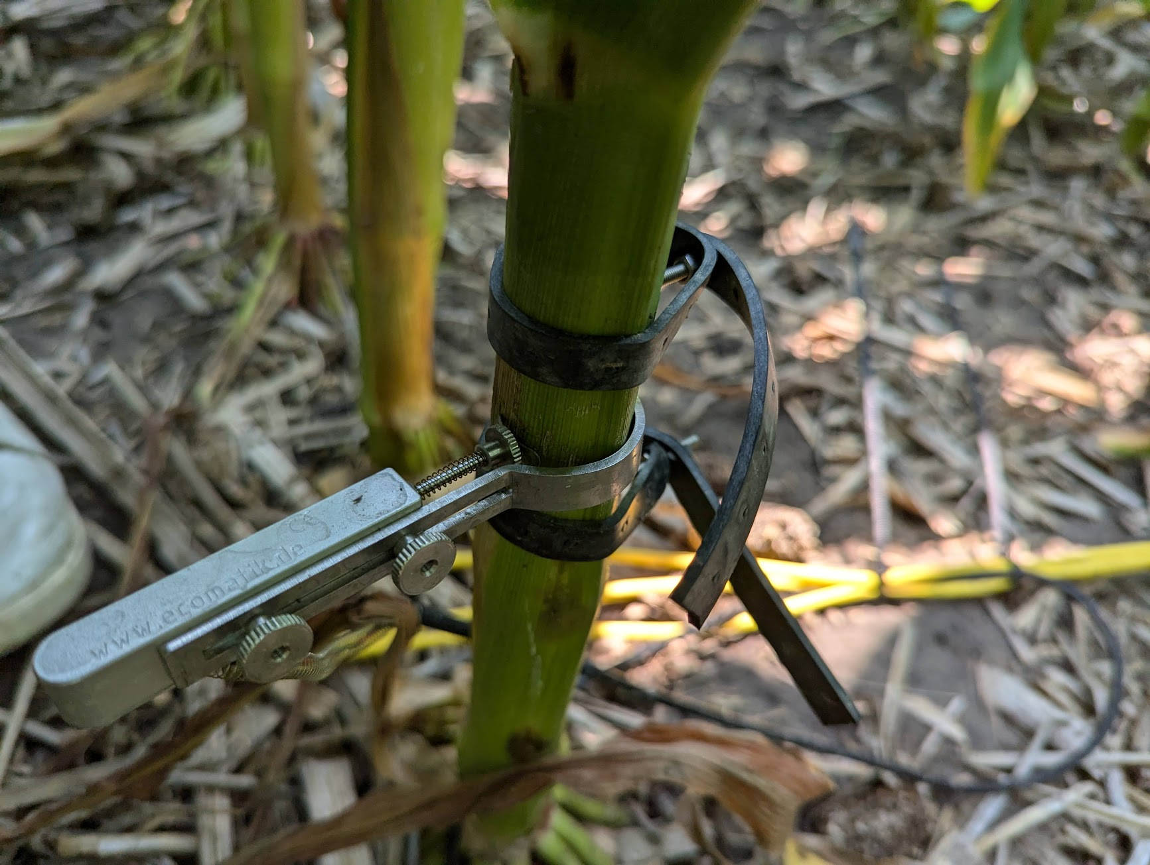
Data Collection System Overview
1
1
2
2
3
3

Slide 12
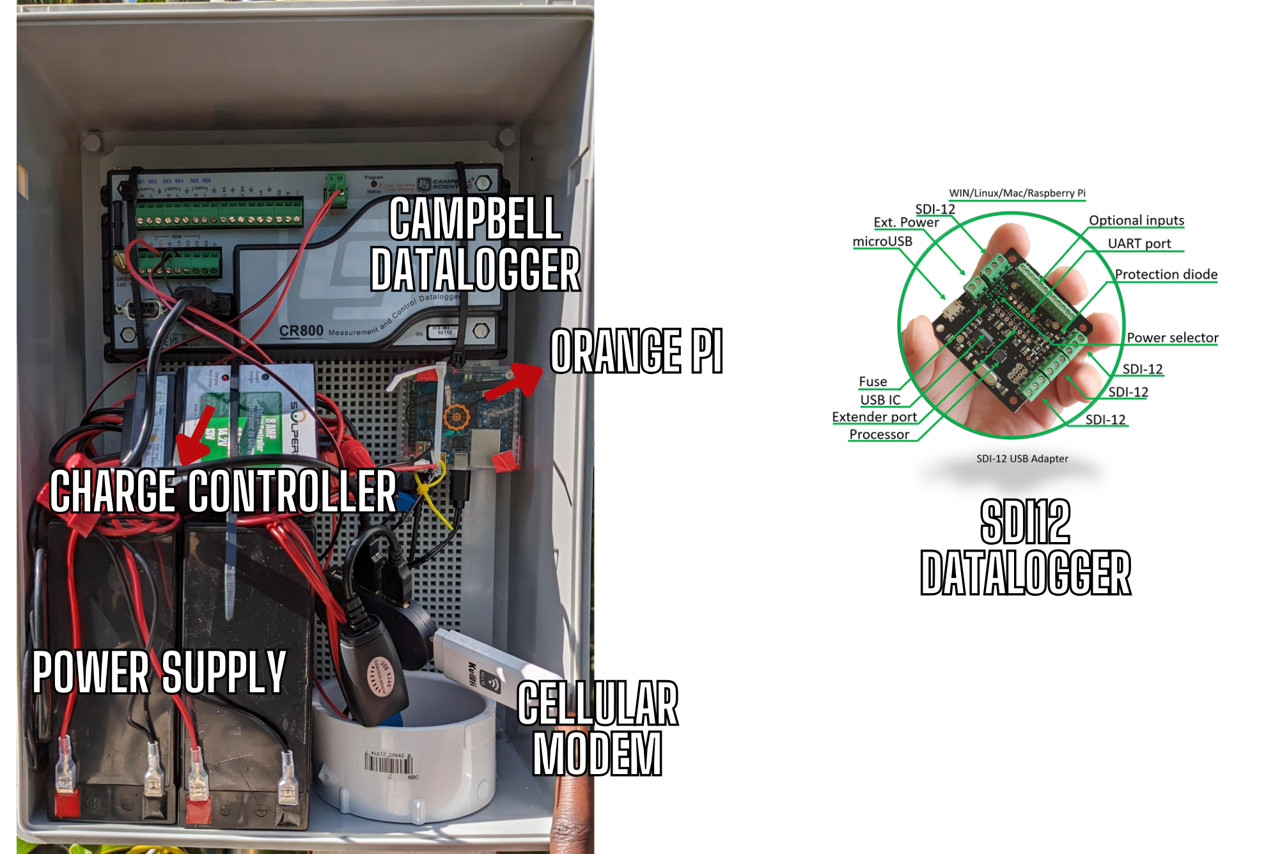
Data Collection hARDWARE - Dataloggers
Managed by Raspberry Pi 4
PiSupply Lora Hat for Lora Transmission
Linovision Lorawan Gateway
12V, 14Ah Lithium batteries
30W solar panels
2 Data Logging options

Slide 13
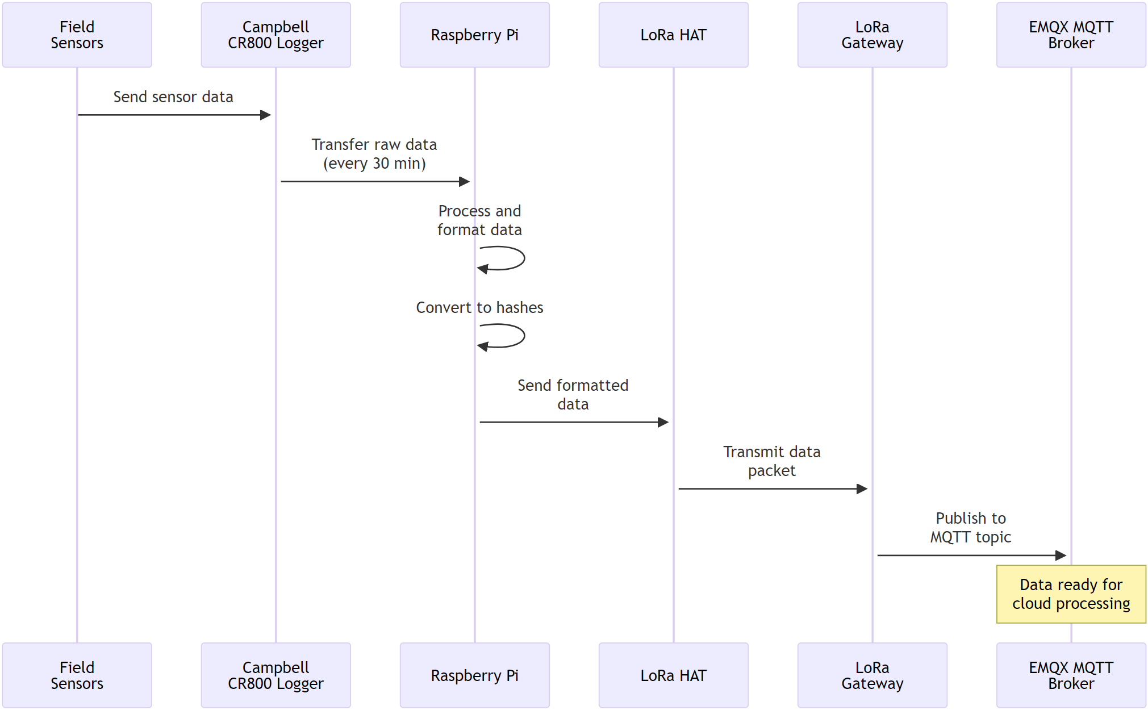
Field to Cloud: Data Collection
Sensors collect data every 30 minutes
Local processing on Raspberry Pi
LoRa transmission to gateway
MQTT broker aggregates field data
Real-time data streaming enabled

Slide 14
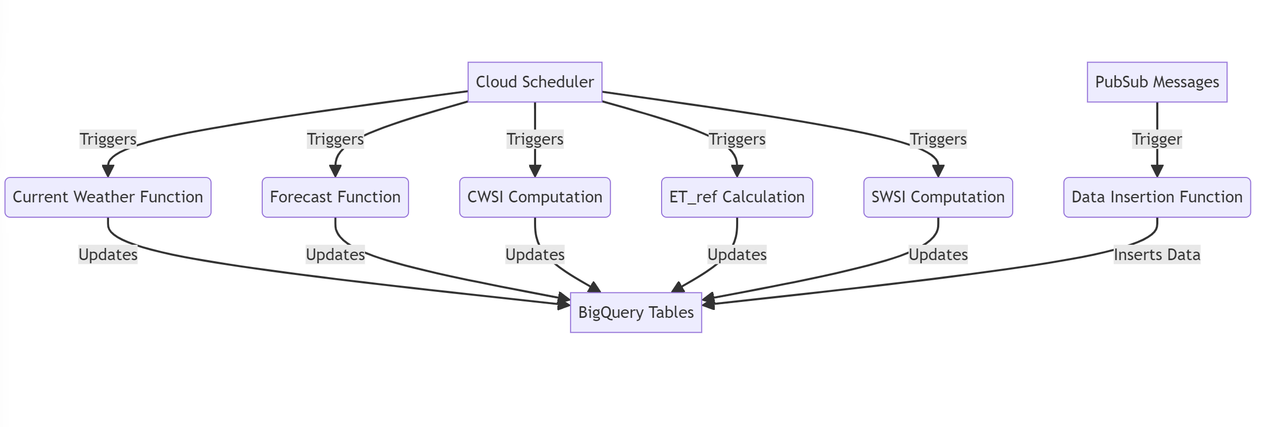
Cloud Functions Workflow
CWSI, ET_ref, SWSI computed on schedule
Data insertion function triggered by PubSub messages
All results stored in BigQuery for analysis
Weather data: OpenWeatherMap API (current and 4-day forecast)
Mesonet API: local high-precision weather data
Cloud Scheduler triggers functions periodically

Slide 15
Fuzzy Logic for irrigation Scheduling

Slide 16
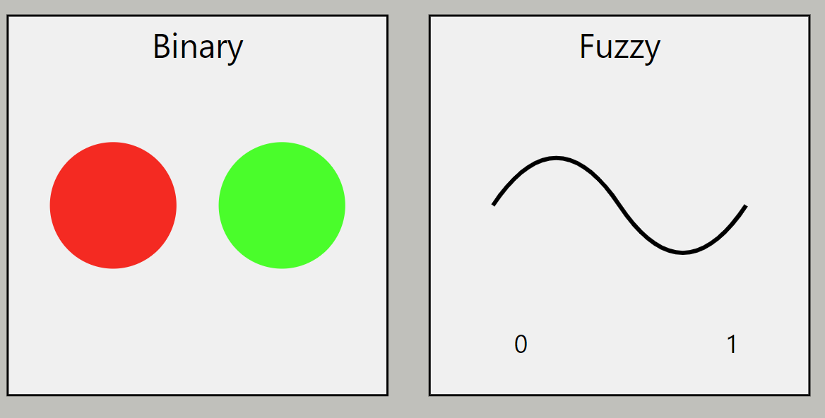
Introduction
Traditional approach uses fixed thresholds; fuzzy logic allows for gradual transitions
Fuzzy logic captures real-world imprecision in irrigation decisions (e.g., "somewhat dry" soil)
Better mimics human expert reasoning for complex environmental factors

Slide 17
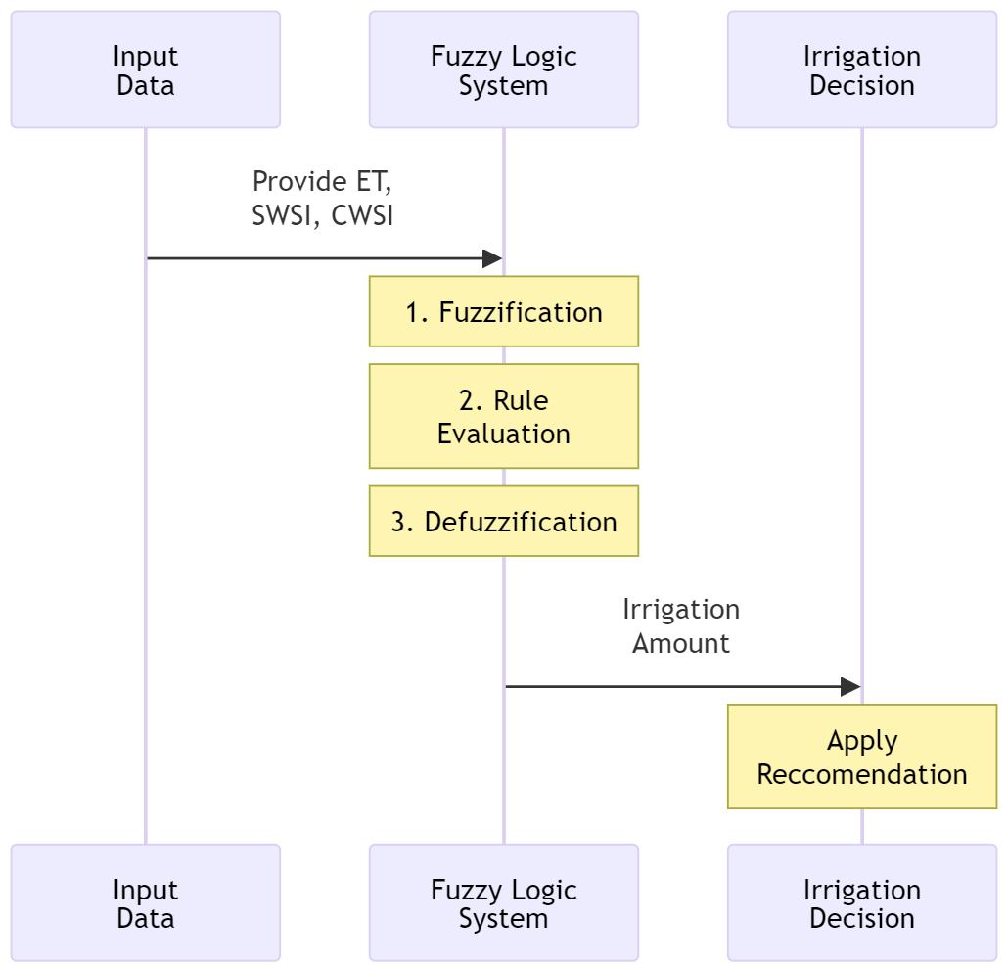
Fuzzy System Components and Process
Inputs: SWSI (Soil Water Stress Index), CWSI (Crop Water Stress Index), ET (evapotranspiration) - key environmental factors
Fuzzification: Convert precise input values into degrees of membership in fuzzy sets
Rule base and inference: Apply expert knowledge to fuzzy inputs, determining irrigation needs
Defuzzification: Convert fuzzy conclusions into a precise irrigation amount
Output: Final recommended irrigation quantity

Slide 18
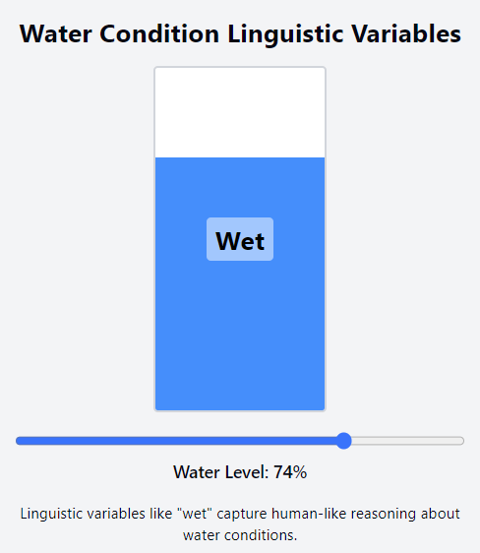
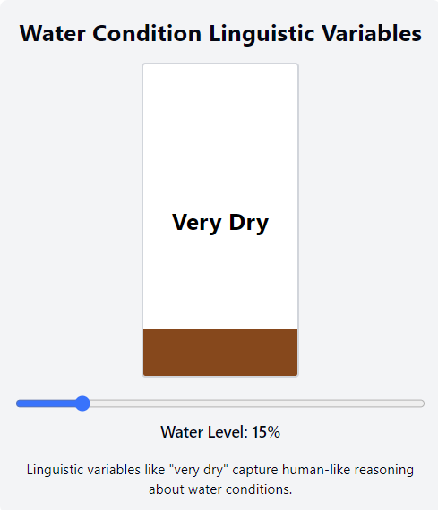
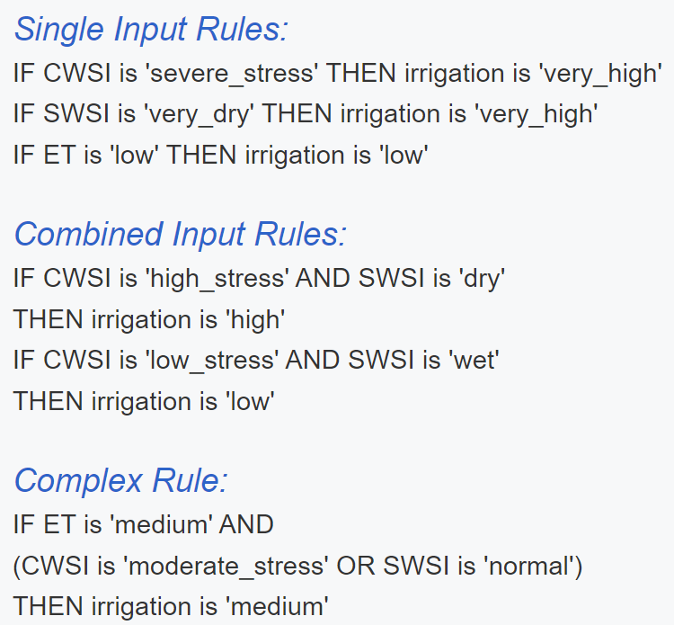
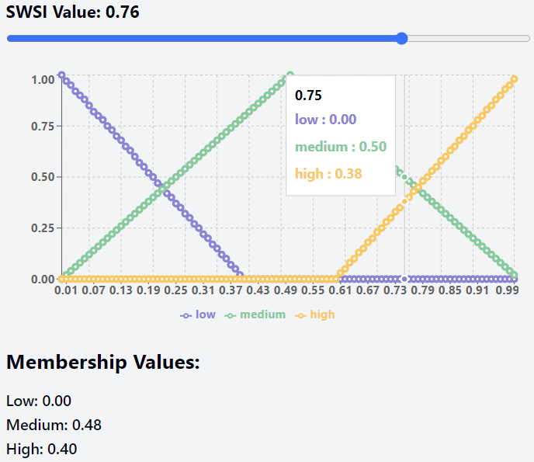
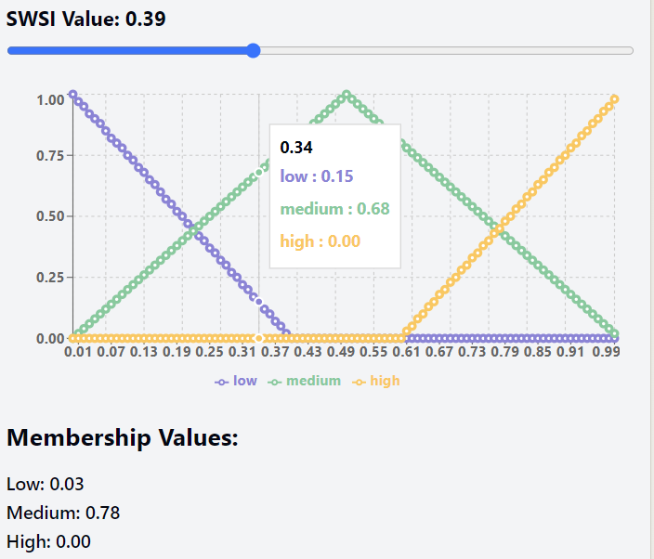
Fuzzification and Membership Functions
Converting crisp inputs (e.g., SWSI of 0.7) to fuzzy values (e.g., 70% 'dry', 30% 'normal’)
Overlapping functions allow smooth transitions, reflecting real-world ambiguity in categories
Linguistic variables like "dry" or "wet" capture human-like reasoning about water conditions
Fuzzy Rules and Inference
Rules use IF-THEN structure to encode expert knowledge about irrigation decisions
Multiple rules can fire simultaneously, each contributing to the final decision
Rule strength depends on the degree of membership of input values in rule conditions

Slide 19
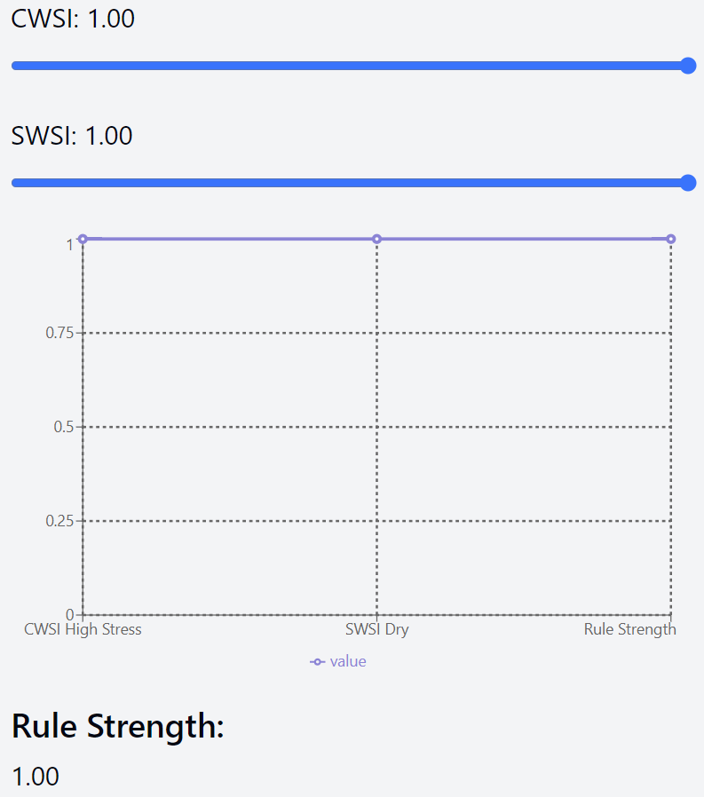
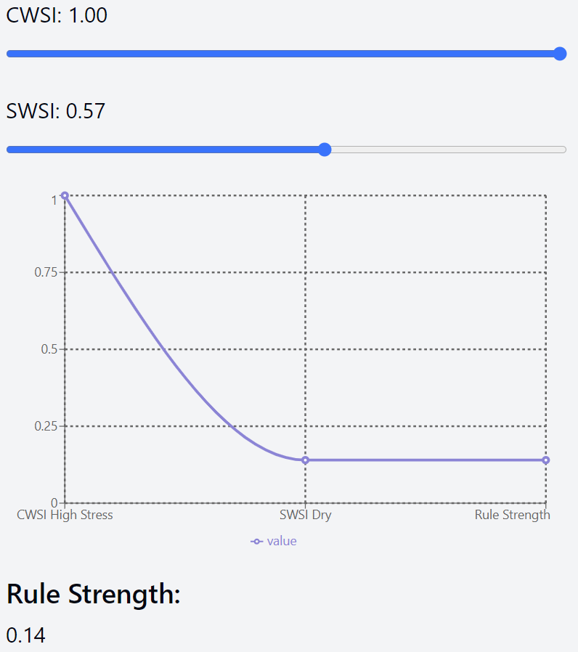
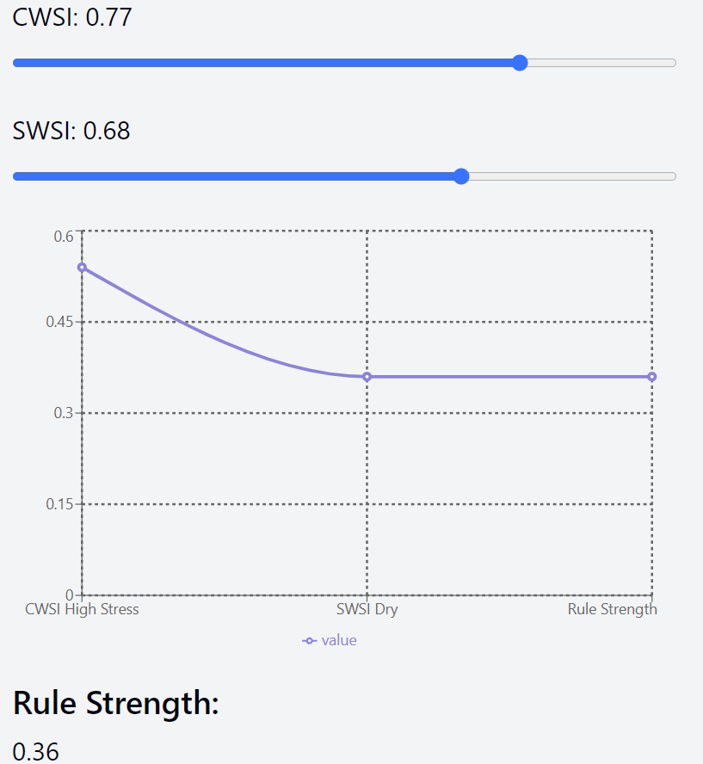
DETERMINING THE STRENGTH OF EACH RULE
Crisp inputs are fuzzified into degrees of membership in input fuzzy sets
Each rule is evaluated using these fuzzified inputs
For rules with multiple conditions (e.g., IF A AND B THEN C):
Use the minimum of individual condition strengths
Example: IF CWSI is 'high_stress' (0.7) AND SWSI is 'dry' (0.8) THEN strength = min(0.7, 0.8) = 0.7
The resulting strength is applied to the rule's consequent (output) fuzzy set
This process is repeated for all rules in the system
Rule: IF CWSI is 'high_stress' AND SWSI is 'dry' THEN irrigation is 'high'

Slide 20
Defuzzification
Aggregating rule outputs: Combine all activated rules into a single fuzzy output set
Centroid method finds the "balance point" of the aggregated fuzzy set
This balance point becomes the crisp (precise) irrigation amount recommendation

Slide 21
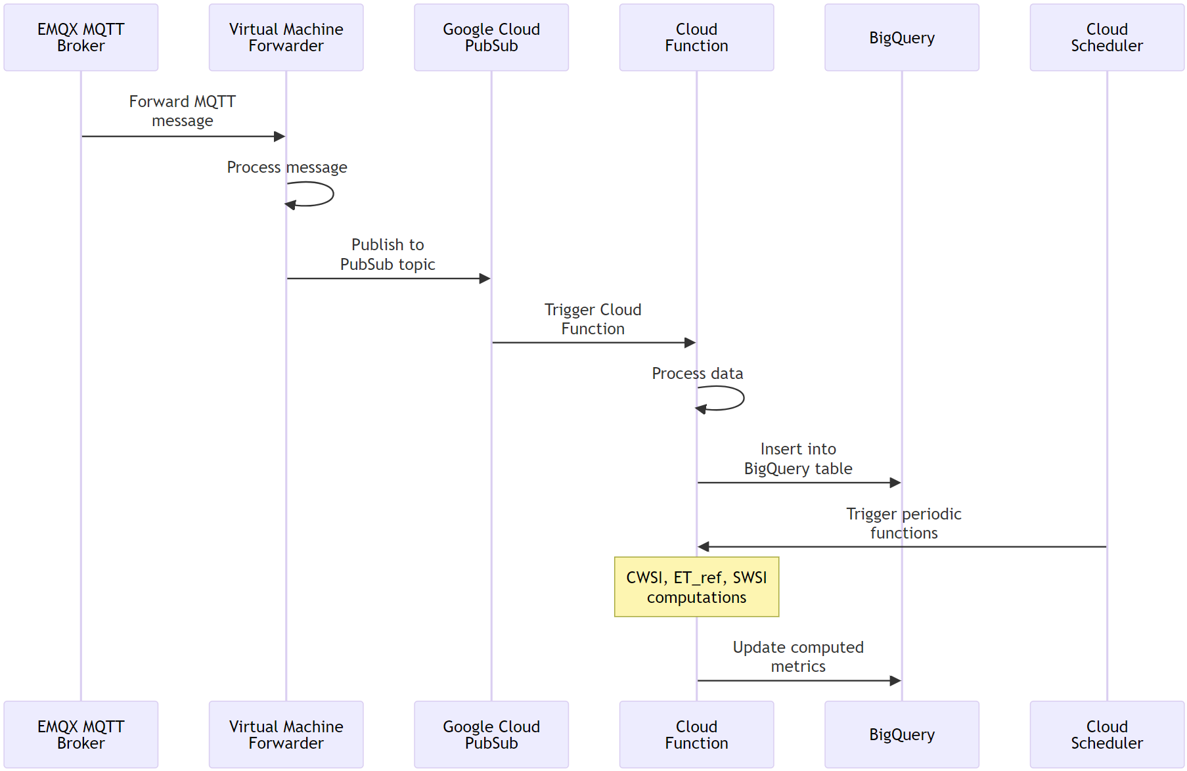
Cloud to Analysis: Data Processing
VM forwarder prepares data for cloud
Google Cloud PubSub for scalable messaging
Cloud Functions process incoming data
BigQuery stores and enables complex analytics
Scheduled functions compute irrigation metrics

Slide 22
Cloud to Analysis: Data Processing
VM forwarder prepares data for cloud
Google Cloud PubSub for scalable messaging
Cloud Functions process incoming data
BigQuery stores and enables complex analytics
Scheduled functions compute irrigation metrics

Slide 23
Cloud to Analysis: Data Processing
VM forwarder prepares data for cloud
Google Cloud PubSub for scalable messaging
Cloud Functions process incoming data
BigQuery stores and enables complex analytics
Scheduled functions compute irrigation metrics

Slide 24
Cloud to Analysis: Data Processing
VM forwarder prepares data for cloud
Google Cloud PubSub for scalable messaging
Cloud Functions process incoming data
BigQuery stores and enables complex analytics
Scheduled functions compute irrigation metrics

Slide 25
Conclusions and Future Work
IoT system successfully integrates diverse sensors
LSTM model shows promise for soil moisture prediction
Challenges in capturing irrigation effects
Future: Expand dataset, refine feature engineering
Potential for real-time irrigation decision support

Slide 26
THANK YOU!

Slide 27
ML MODELS FOR VWC PREDICTION

Slide 28
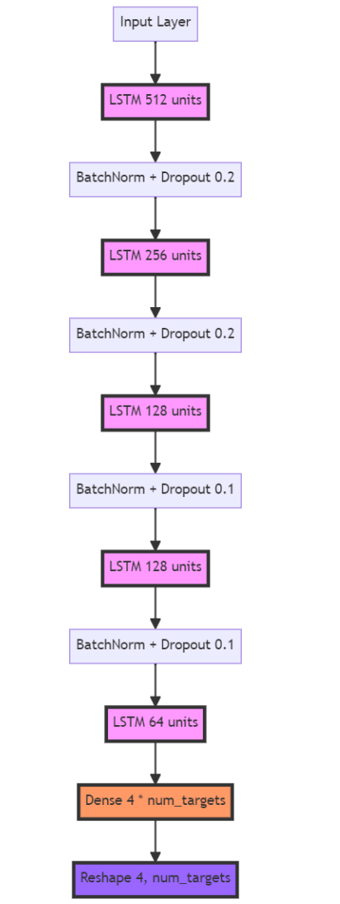
LSTM Model Architecture
Deep learning for irrigation prediction
5 LSTM layers (512 to 64 units)
Dropout and Batch Normalization for regularization
Dense layer output: 4 days x 3 targets
Optimized for soil moisture prediction

Slide 29
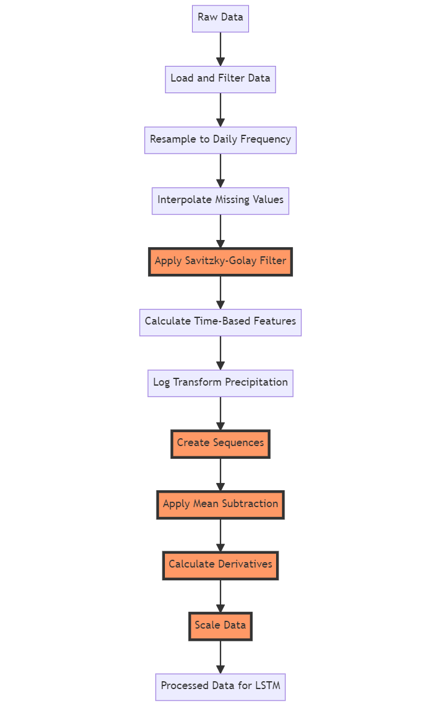
Data Preprocessing for LSTM
Daily resampling of 15-min data (reduce noise, capture daily patterns)
Savitzky-Golay filter: smoothing (preserves features better than moving average)
Log transform for precipitation (handle skewed distribution)
Time-based features: cyclical encoding (capture seasonal patterns)
Sequence creation: 7-day input, 4-day forecast (balance history and future prediction)
PCHIP interpolation for missing values (preserves shape of time series)

Slide 30
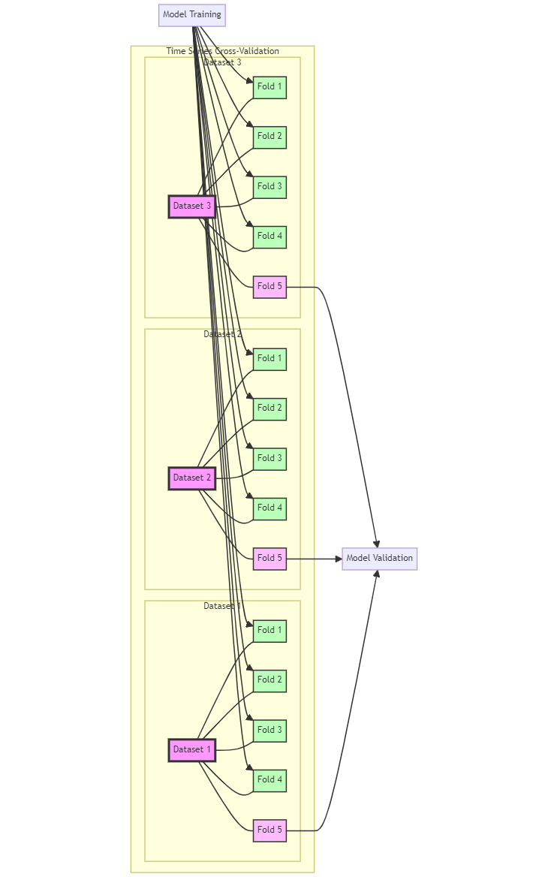
Time Series Cross-Validation
Multiple datasets, same time period (Jul-Sep 2023)
5-fold chronological split
Train on 4 folds, validate on 1
Simultaneous validation across datasets
Preserves temporal order of data

Slide 31
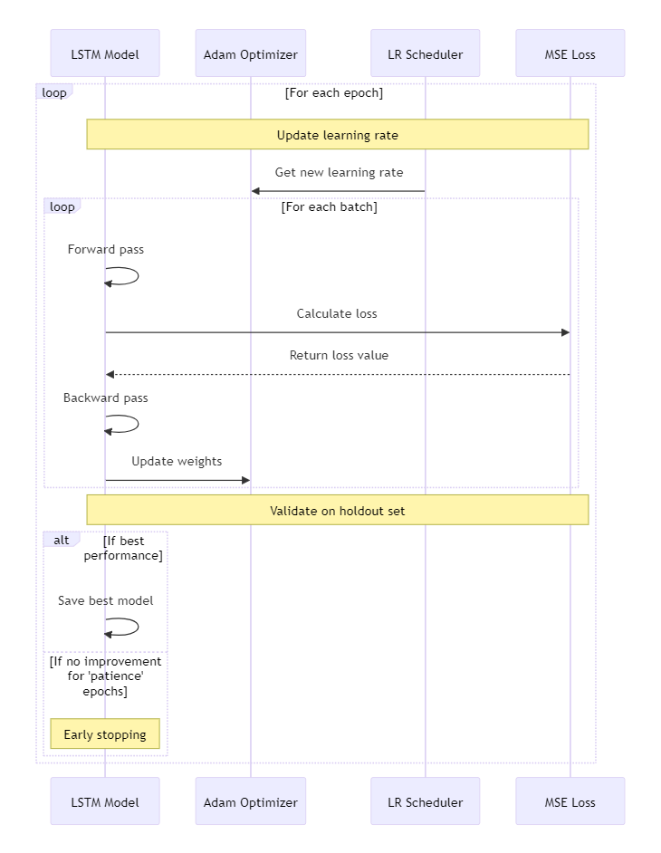
LSTM Training Process
Custom training loop implementation
Adam optimizer with initial LR: 0.001
Learning rate decay after 15 epochs
Early stopping: patience of 200 epochs
Loss function: Mean Squared Error

Slide 32
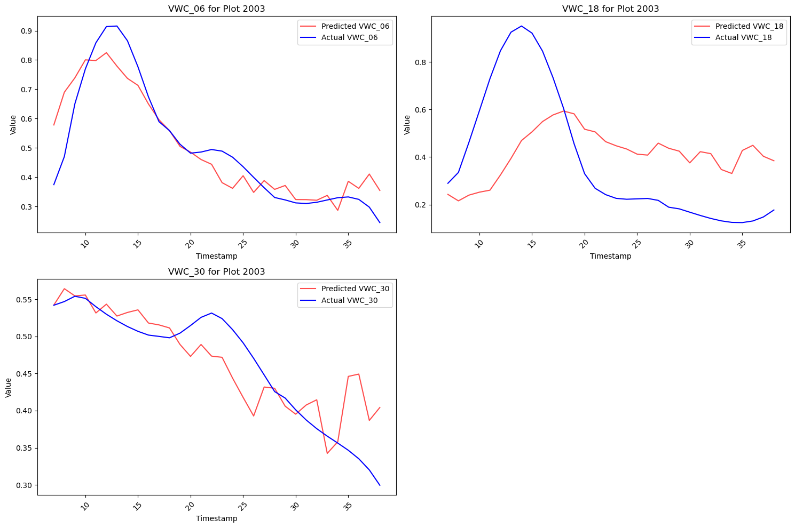
Model Performance on Test Set
Input window: 7 days
Prediction window: 4 days
Sliding forward prediction
Metrics: RMSE, MAE for each soil depth
Comparison with baseline models

Slide 33
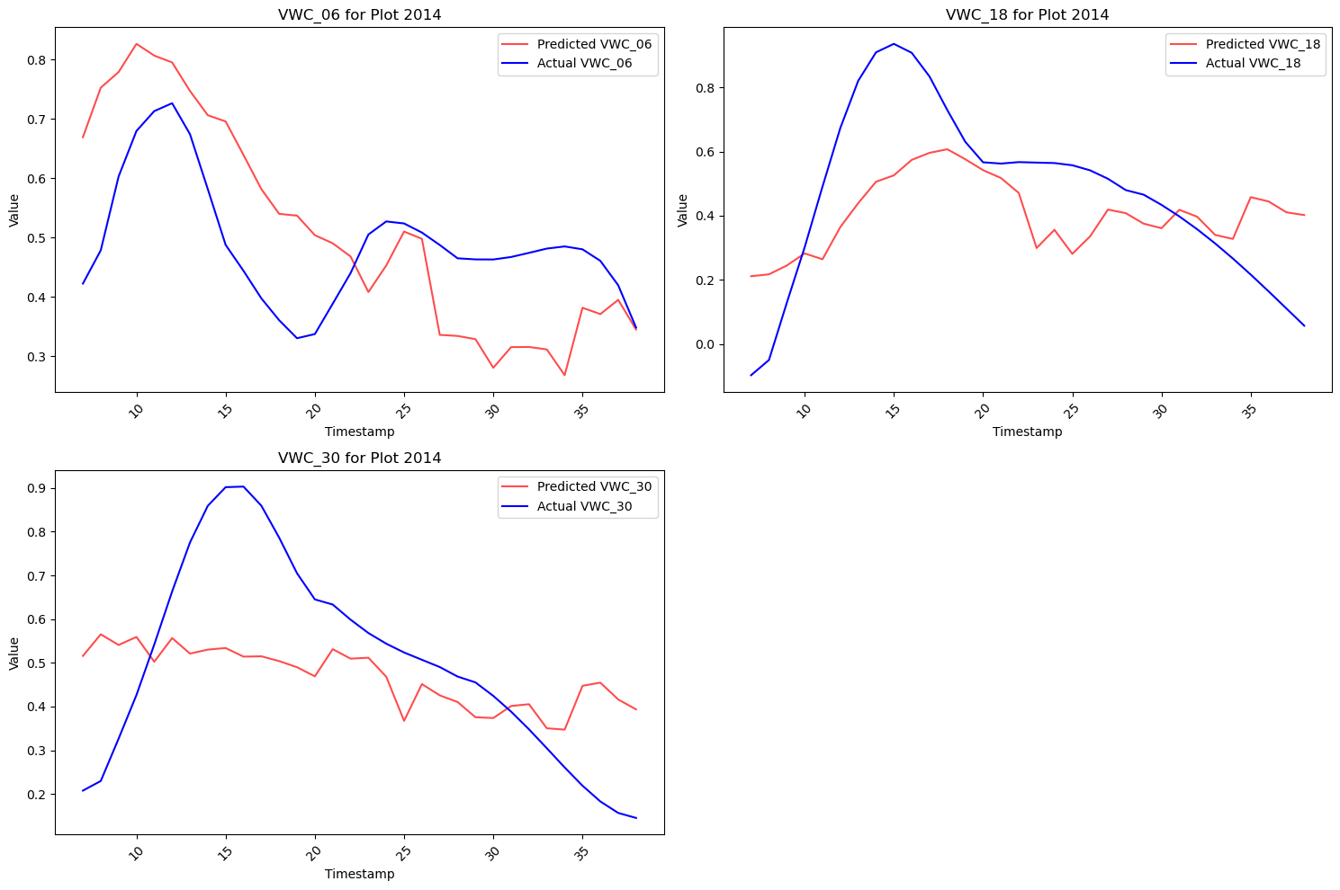
Model Performance on Test Set
Input window: 7 days
Prediction window: 4 days
Sliding forward prediction
Metrics: RMSE, MAE for each soil depth
Comparison with baseline models

Slide 34
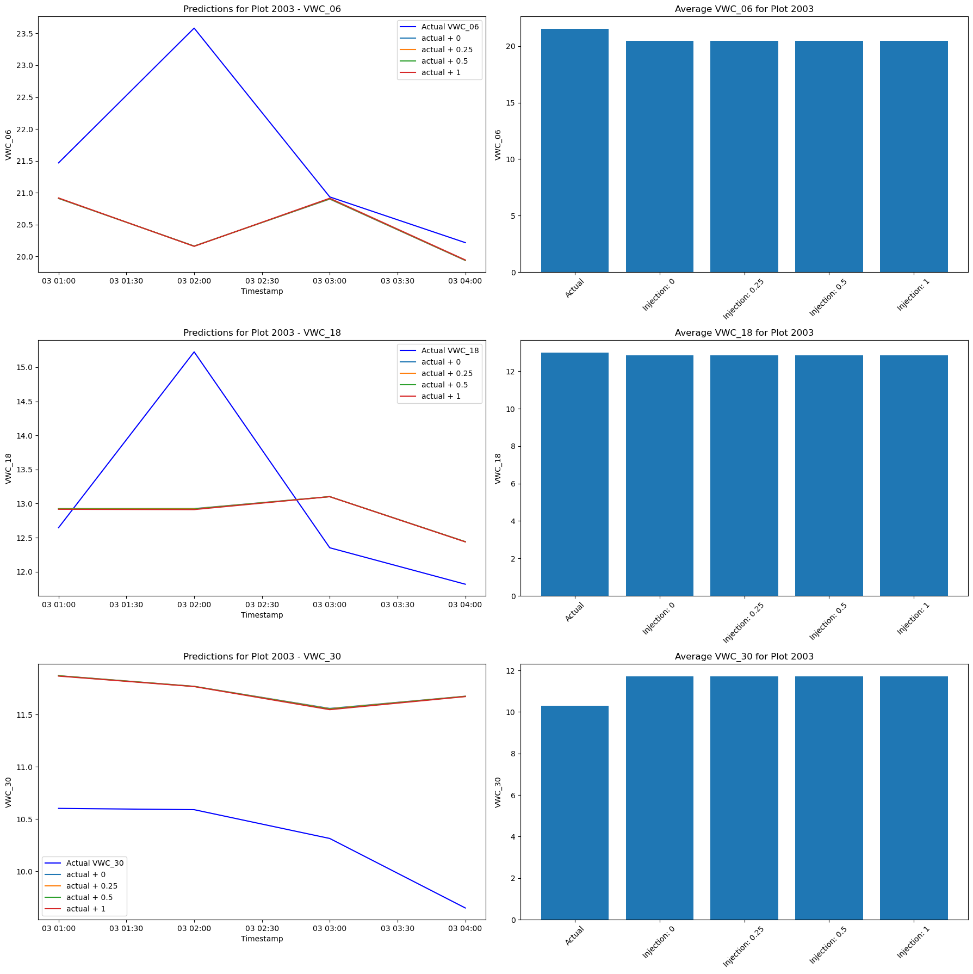
Irrigation Injection Simulation
Injection amounts: 0, 0.25, 0.5, 1 inch
Injected at end of input sequence
Prediction horizon: 4 days post-injection
Model showed limited sensitivity to injection
Possible reasons: data sparsity, feature dominance

